Slide 1





FACEBOOK
API

Slide 2


01
02
03
04
Duration
Group
Evaluation
Features
05
Submit

Slide 3



DURATION
The project starts on June 10, 2024, and ends on the evening of June 17, 2024.
We have 9 sessions scheduled for the project.

Slide 4




GROUP
In this project, we will divide the group into three. All members need to implement their assigned coding tasks. Each team must meet with the coach once a week for clarification and guidance.
Each team needs to hold a daily stand-up meeting to summarize what has been done, identify any problems, and outline the next steps for each member. The team should then send a report to the coach.
For this project, you can use GitHub to create your team repository.

Slide 5

EVALUATION
For the evaluation, we have divided it into three parts:
Code
API documentation
80%
20%
CODE
API DOCUMENTS

Slide 6
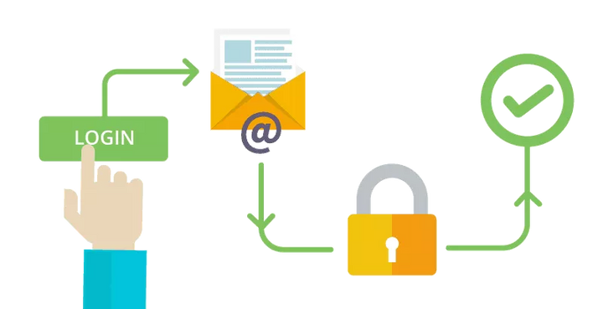
1.USER AUTHENTICATION:
Register
Login
Logout
Forgot password(optional)

Slide 7

2.USER PROFILE MANAGEMENT:
View and edit user profile
Upload profile picture

Slide 8
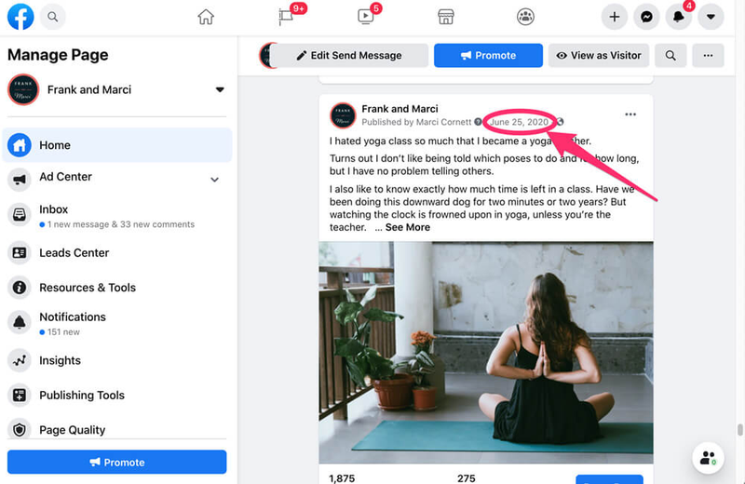
3.POST MANAGEMENT:
Create a new post
Retrieve a list of posts
Retrieve a single post
Update a post
Delete a post

Slide 9

4.COMMENT MANAGEMENT:
Add a comment to a post
Retrieve comments for a post
Delete a comment

Slide 10

5.LIKE FUNCTIONALITY:
Like or unlike a post
Retrieve the list of likes for a post

Slide 11

6.FRIENDSHIP MANAGEMENT:
Send a friend request
Accept or decline a friend request
Retrieve the list of friends
Remove a friend

Slide 12



SUBMIT
01
We need your project repository, and please remember to include your database.
02
Please send your API documentation describing your REST API, including endpoints, request bodies, validation handling, and success responses.
03
Please record a video demonstrating the tasks you completed using Postman API and export the collection as a JSON file from Postman as well.

